Slide 1
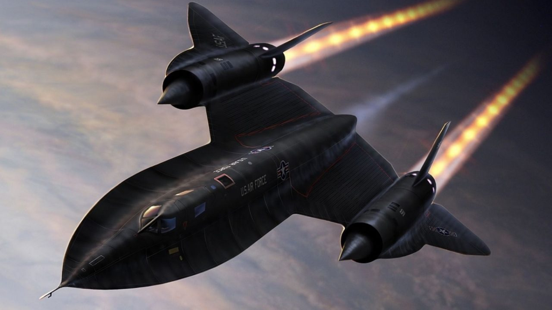
SR-71A Blackbird
Solidworks Final Project
Notes:
Nick

Slide 2
Group A5 Members:
Nick McCullough
Ryan Dunn
Josh Hediger
Akhilesh Nevatia
David Lane
Notes:
Nick

Slide 3
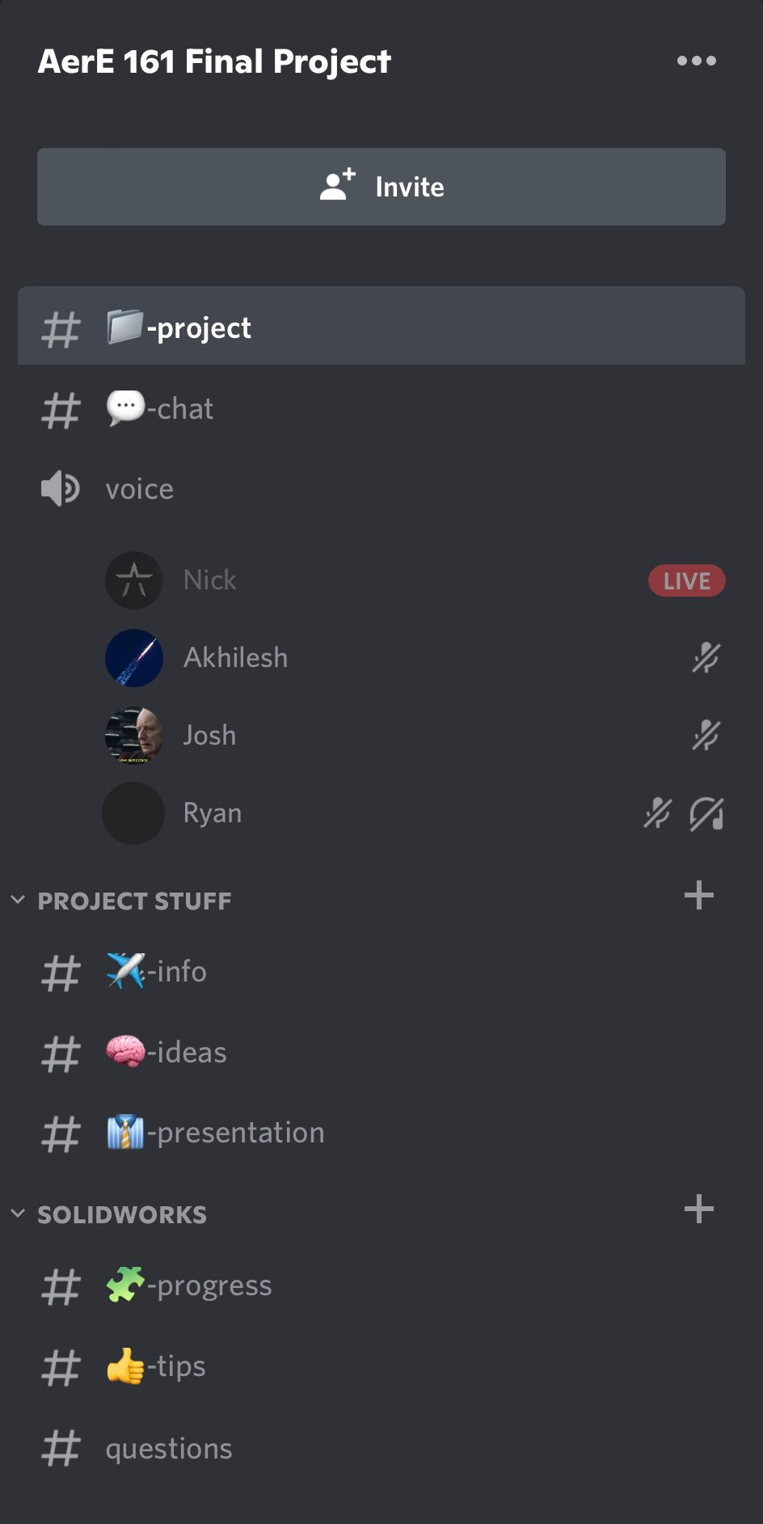
Communication
We created a discord server to communicate, share ideas and work together virtually on the project and a google drive to share Solidworks parts
The discord server included multiple sections:
Project
Chat
Voice
Ideas
Presentation
Progress
Tips
Notes:
Nick

Slide 4
Timeline
28 Mar.
Collectively decided on SR-71 Blackbird while in class
29 Mar.
Rough pre-plan discussed
31 Mar.
Discussed rough dimensions of the plane in discord
4 Feb.
Met in howe hall to construct the front portion of fuselage
4 Apr.
Met in innovation building to construct engine, rudders, start rear fuselage
16 Apr.
Met howe hall to begin cockpit, finishing touches, rear fuselage continued
24 Apr.
Met in innovation building to finish rear fuselage, worked on Powerpoint
29 Apr.
Due Date
Notes:
Nick

Slide 5
Notes:
Finished product transition to josh

Slide 6
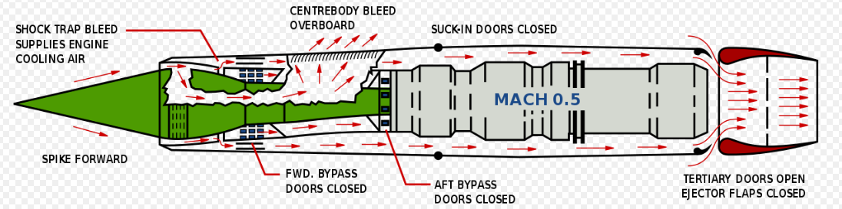
THEORY (Similarity ratios)
Many dimensions were not included
Pratt & Whitney J58 turbojet engine
Notes:
Josh

Slide 7
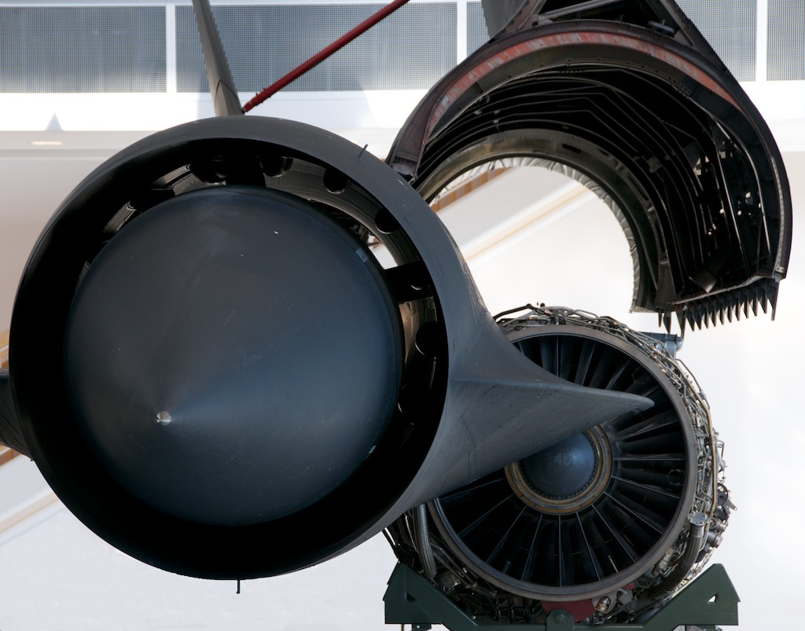
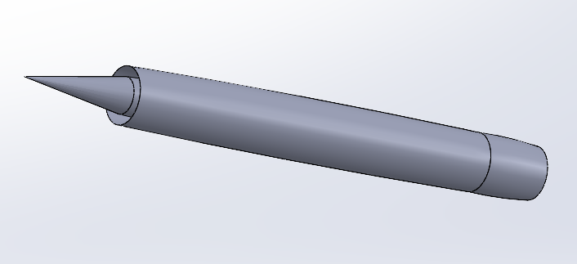
Engine
Turbojet Engine
Conical inlet spike (ramjet)
Notes:
Josh

Slide 8
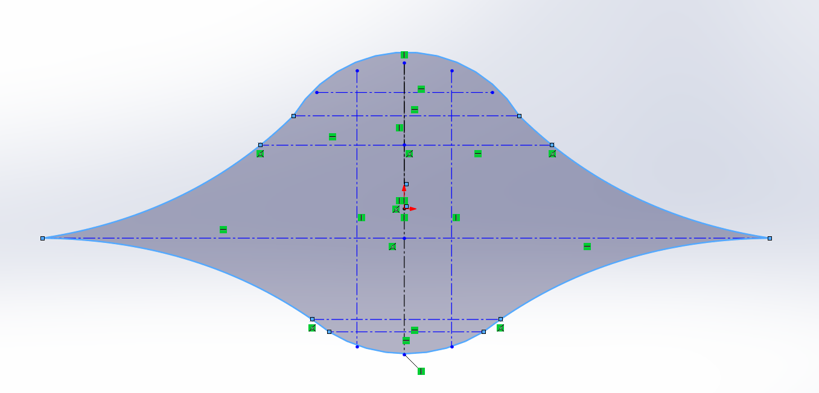
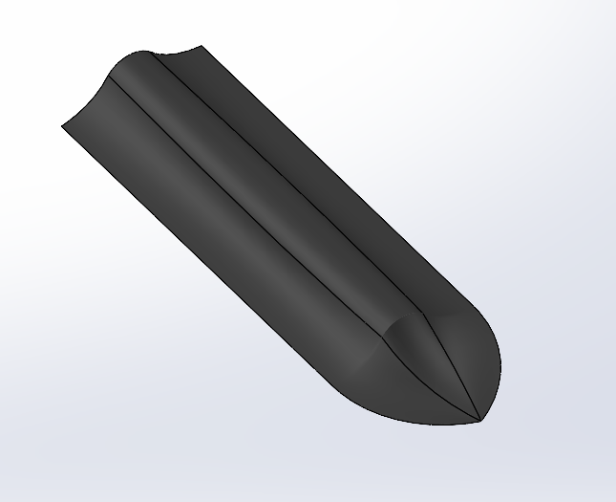
Front Fuselage (CHINE)
Our starting point for the project was the fuselage where the front meets the rear, splitting the aircraft in “half”
We extruded this 2D sketch to a scaled length to the front of the aircraft
We started with the 5.33’ diameter based on the resources
Notes:
Ryan

Slide 9
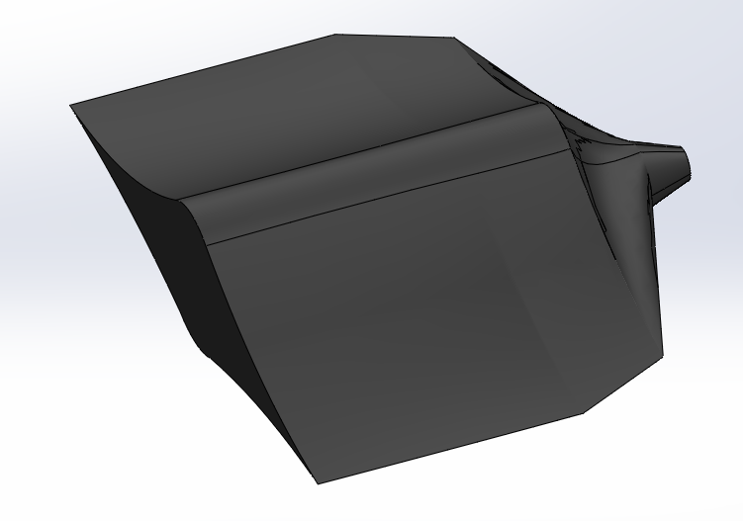
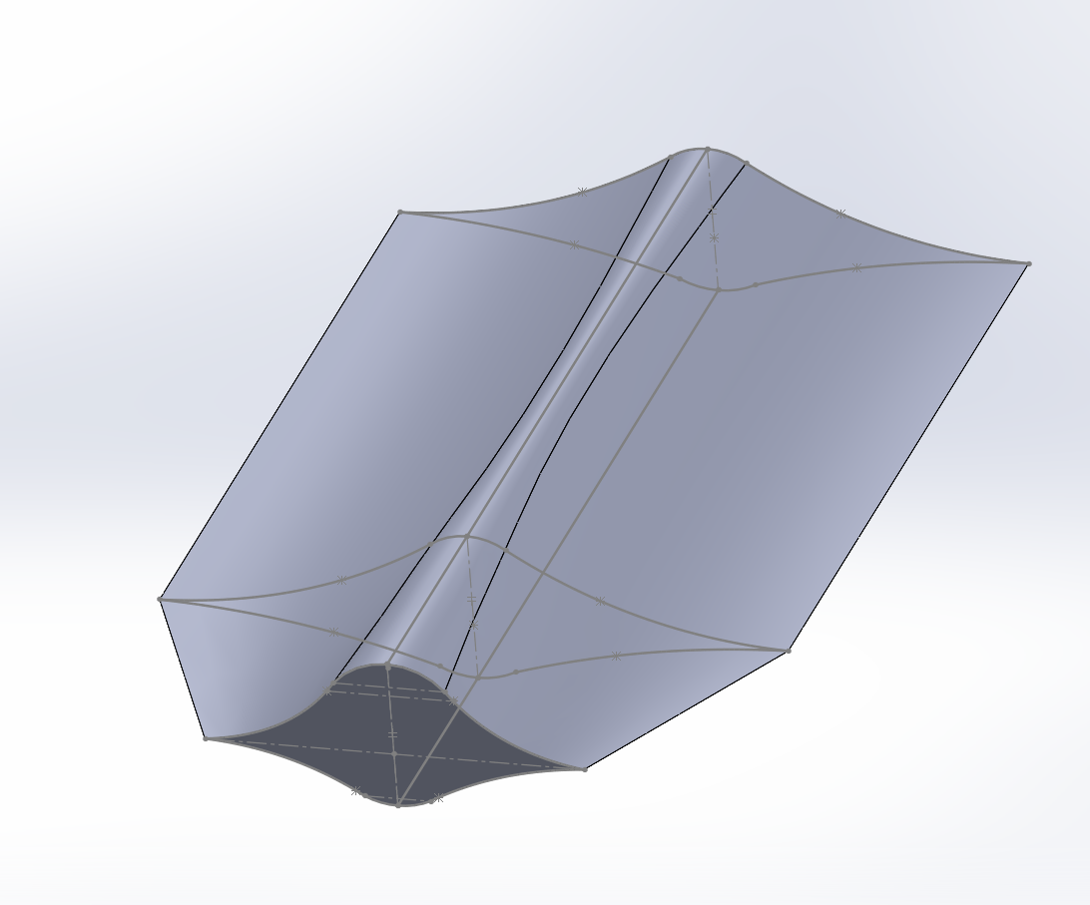
Rear FuselagE (ChINE)
Split in two sections
Notes:
Ryan

Slide 10
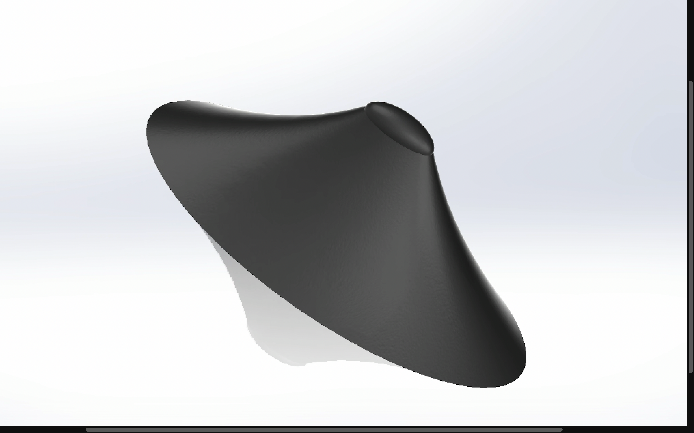
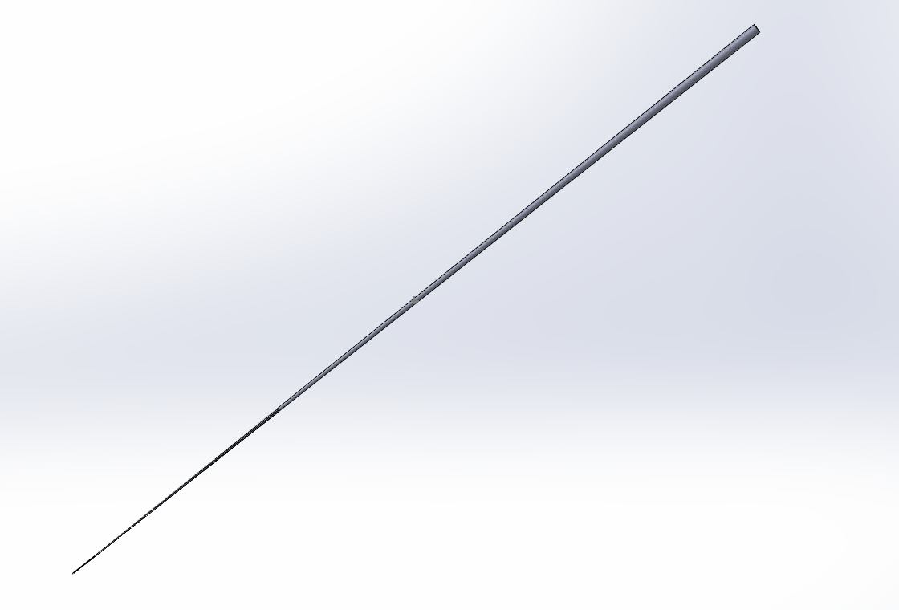
Cockpit & Pressure gauge
Notes:
Akhilesh

Slide 11

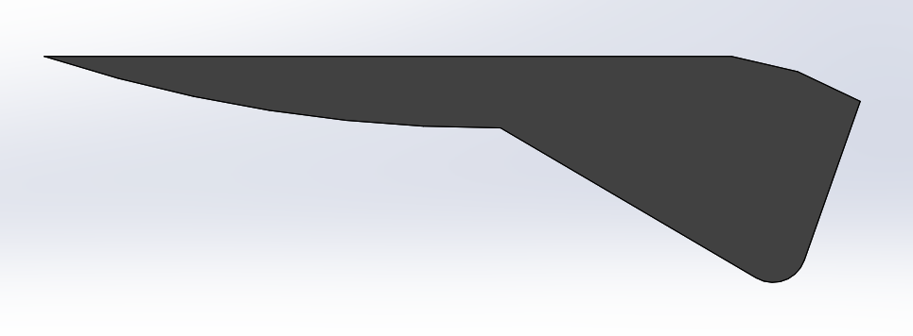
Rudder & wing
Rudder angle 17 degrees
Notes:
David

Slide 12
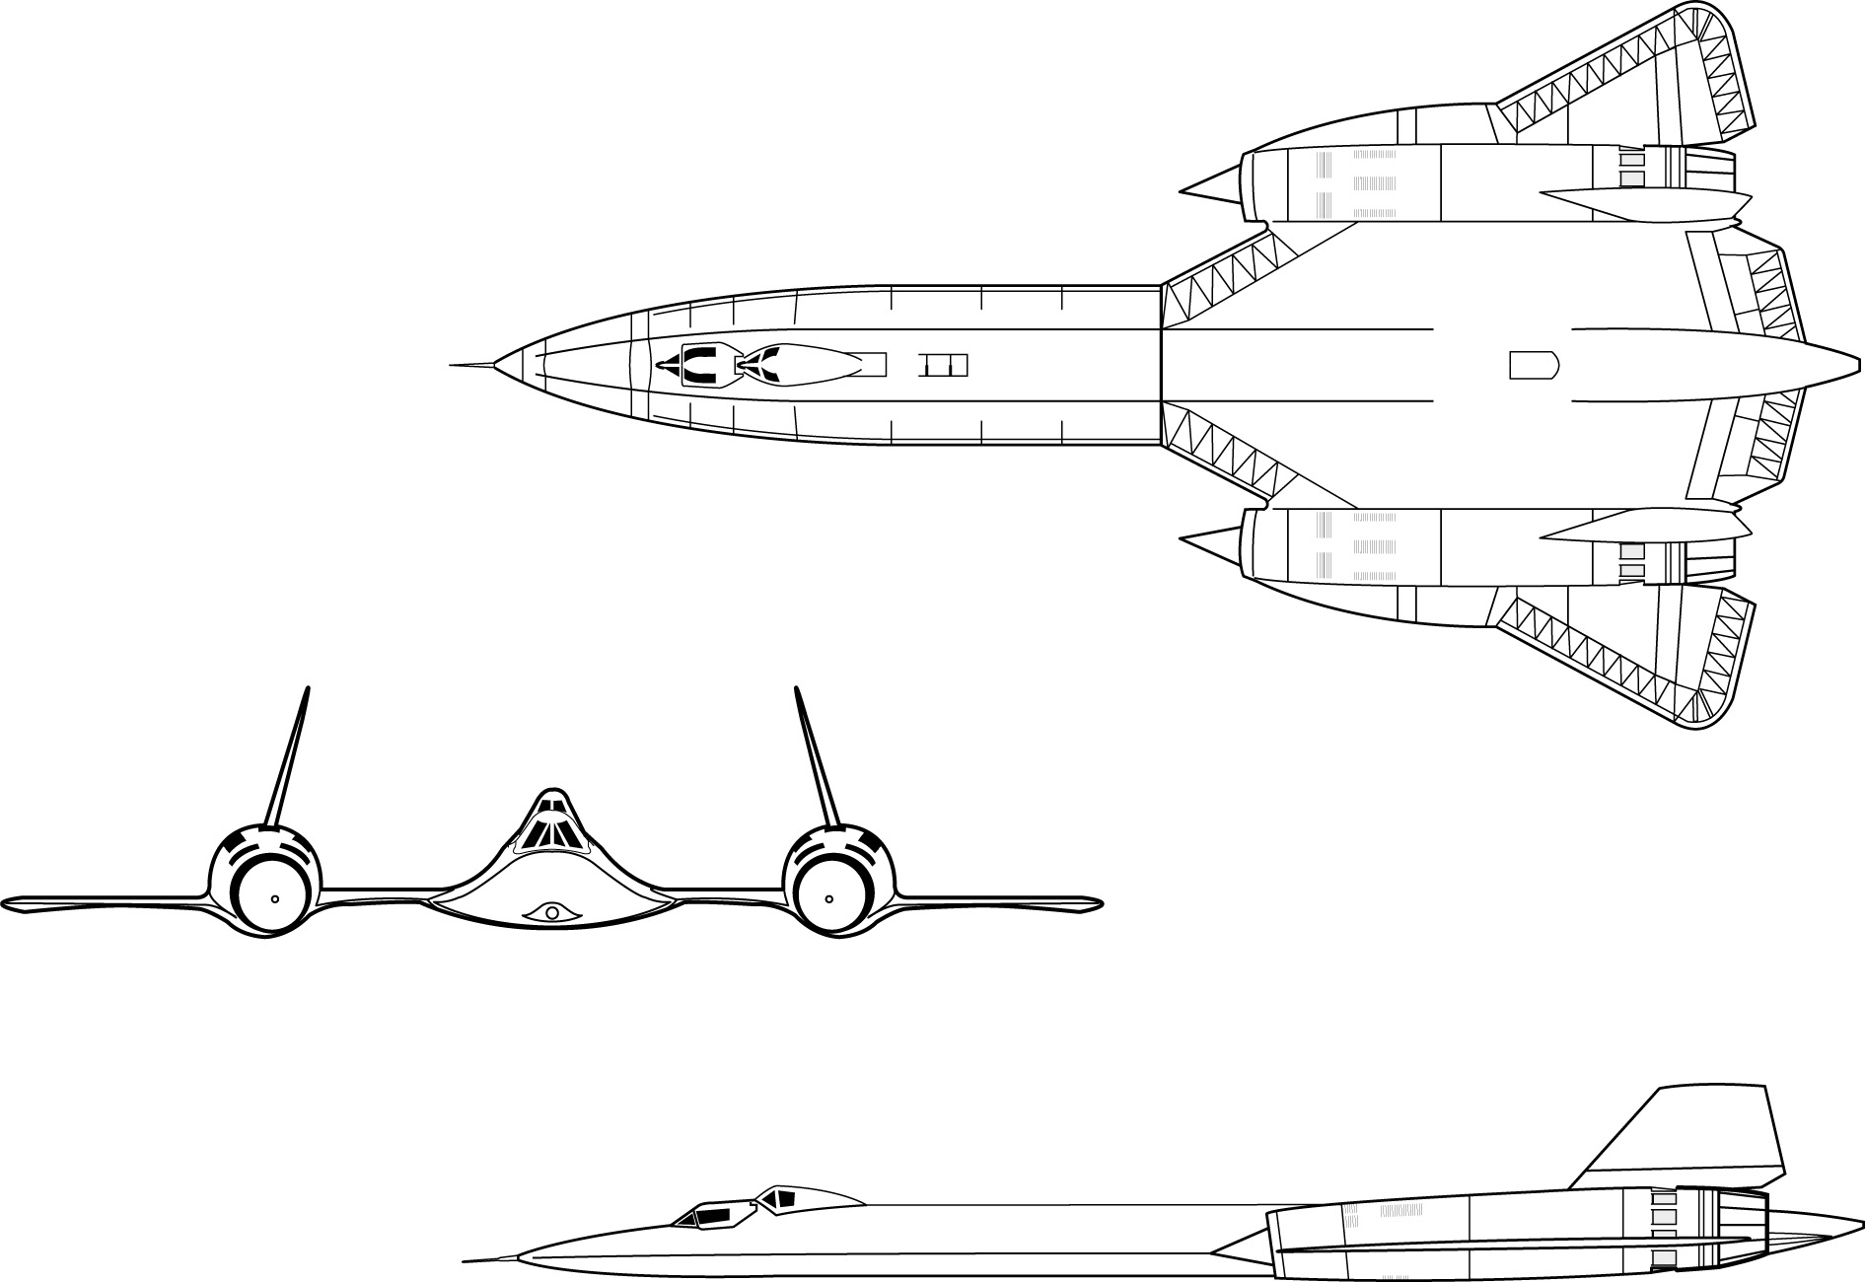
Resources
We sourced most of our information from these websites, including Wikipedia:
https://www.nasa.gov/centers/armstrong/news/FactSheets/FS-030-DFRC.html
https://www.sr-71.org/blackbird/sr-71/
https://aerocorner.com/aircraft/lockheed-sr-71-blackbird/
https://en.wikipedia.org/wiki/Lockheed_SR-71_Blackbird
http://www.fiddlersgreen.net/models/aircraft/Lockheed-SR71.html
Notes:
David

Slide 13
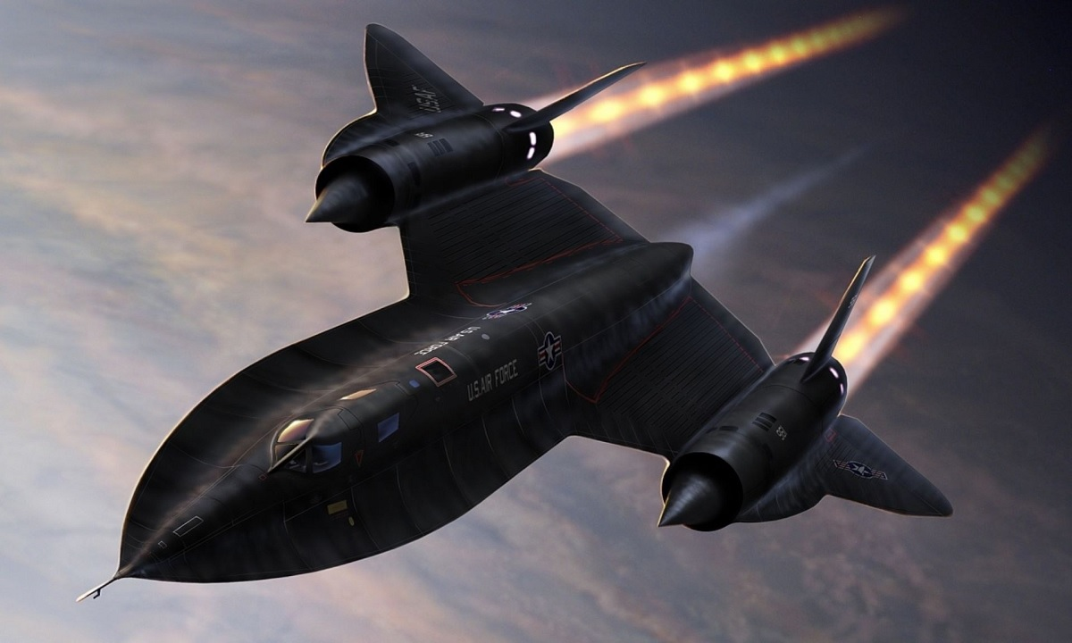
Questions?
Notes:
??

